Slide 1


CAR RENTAL SYSTEM
Project 1 : Object Oriented Programming

Slide 2






PRESENTED BY
Muhamad Farhan Budiana
Gafrilatif Aviandi Putra Adnanta
Muhammad Zidan Satrio

Slide 3



System analysis
FLOWCHART
OUTPUT PROGRAM

Slide 4

01
System analysis

Slide 5

SYSTEM ANALYSIS
we created a simple program based on object oriented programming about a car rental system as an example of a solution so that people can survive and compete in today's conditions where everything is connected to each other by the internet. In this project we created a car rental system using C++ language, and we created a simple menu where customers can rent a car easily just by going through this program without having to meet face to face.

Slide 6
02
FLOWCHART

Slide 7
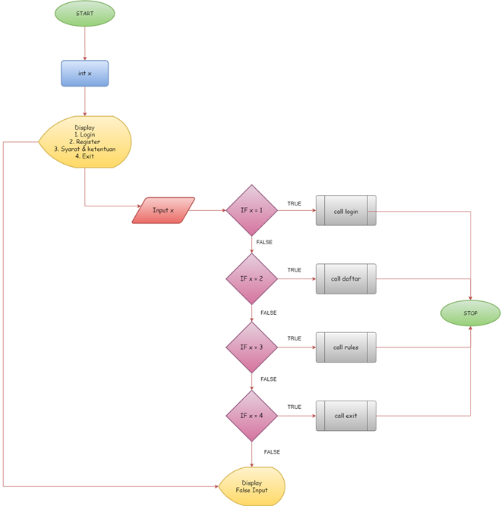
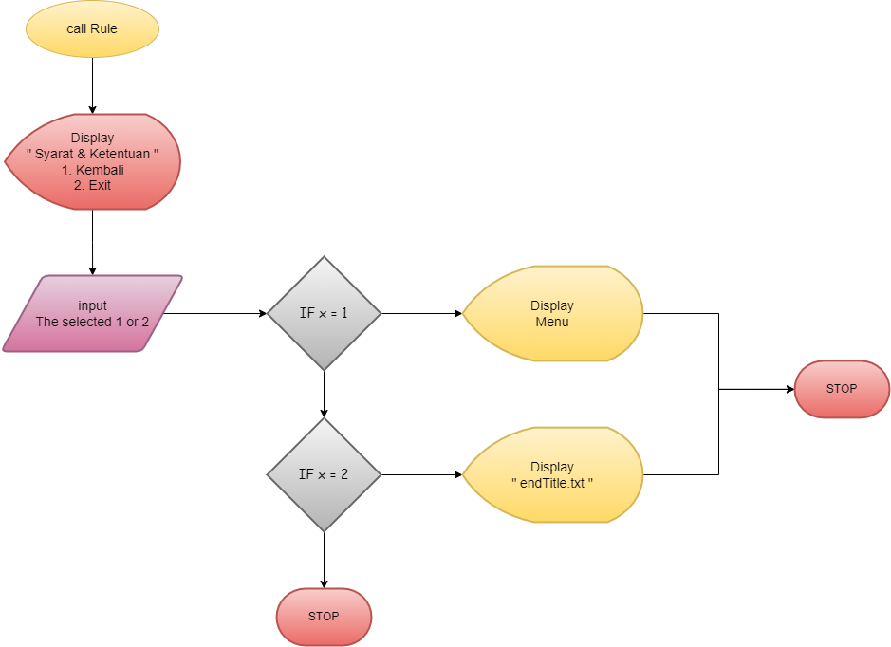
Main Menu
RULES

Slide 8
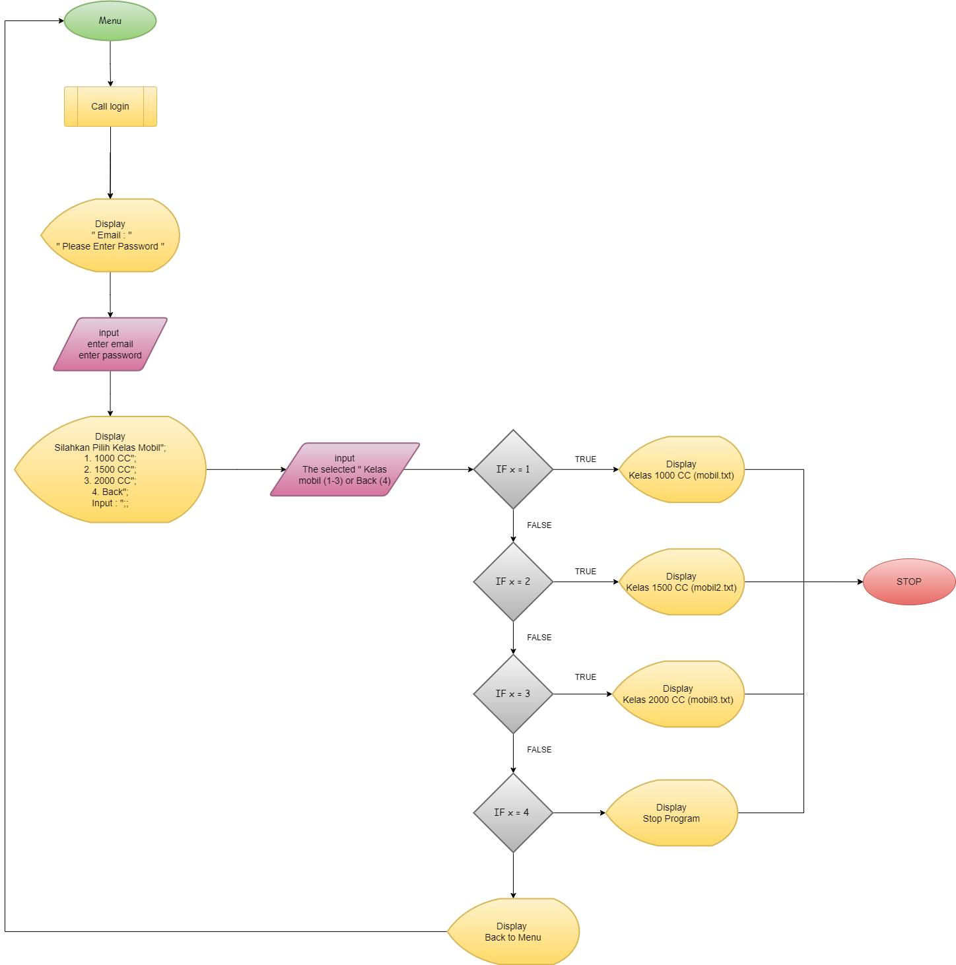
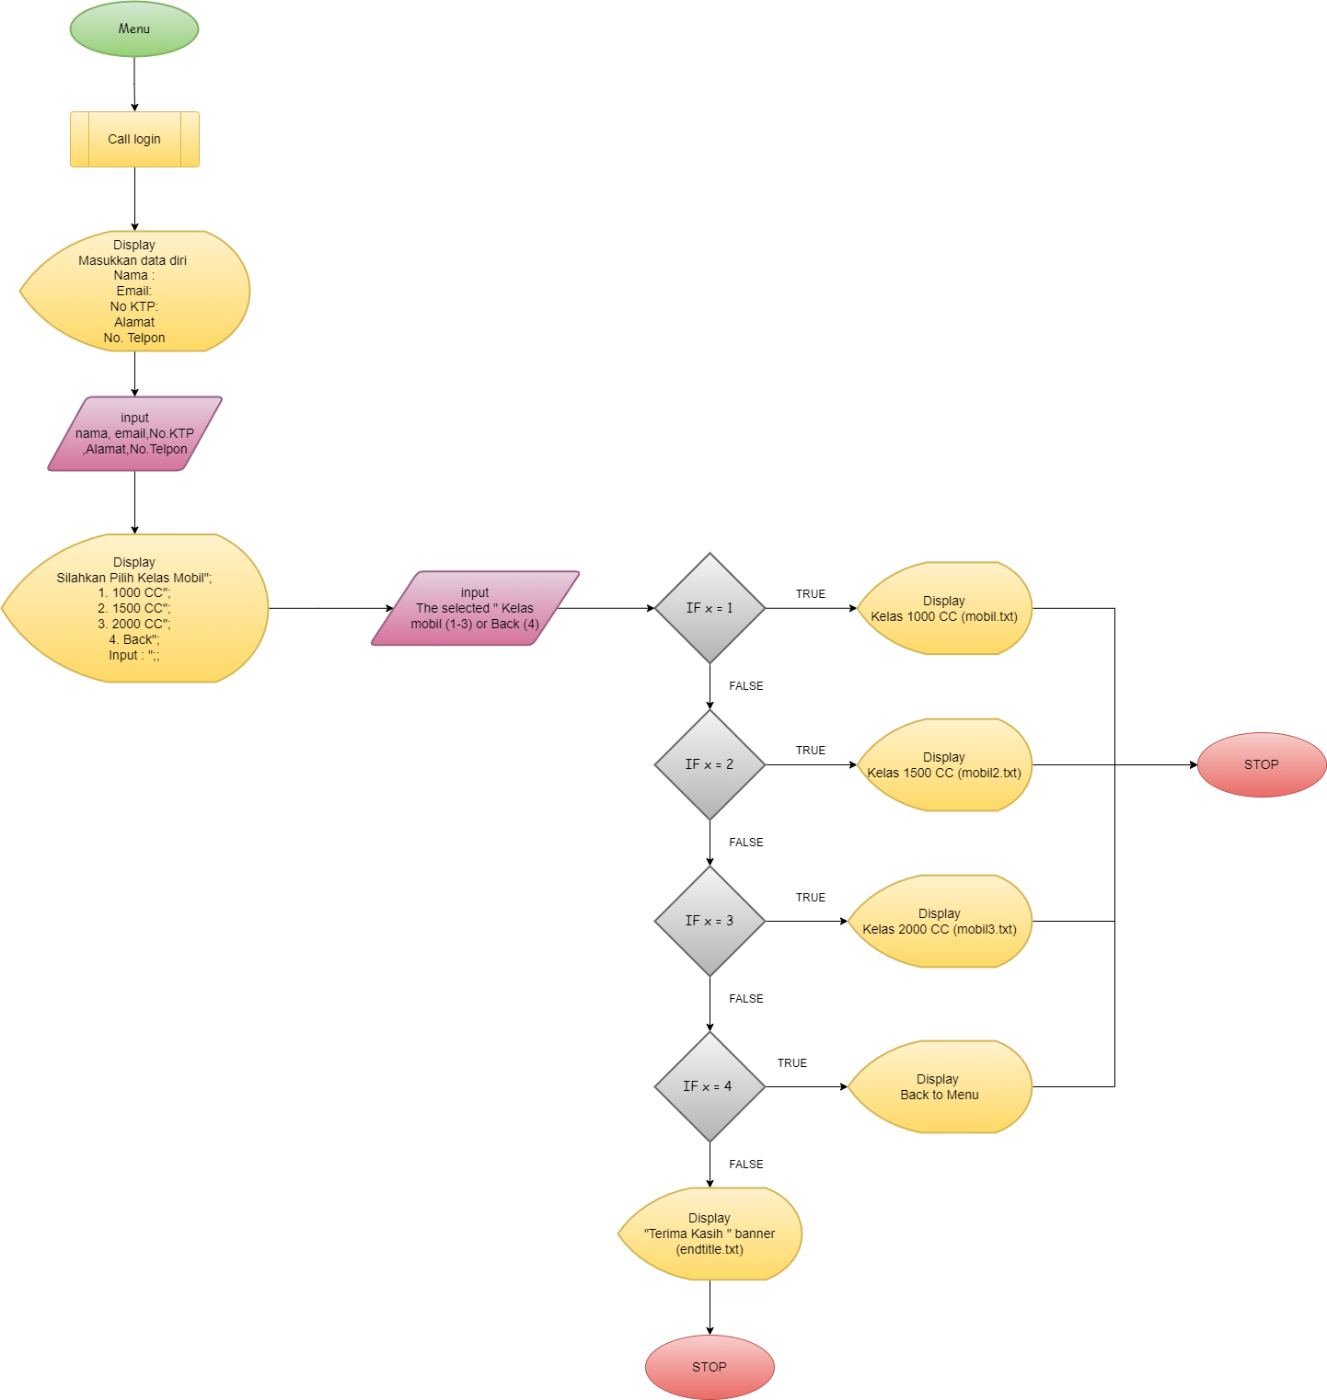
LOGIN
REGISTER

Slide 9
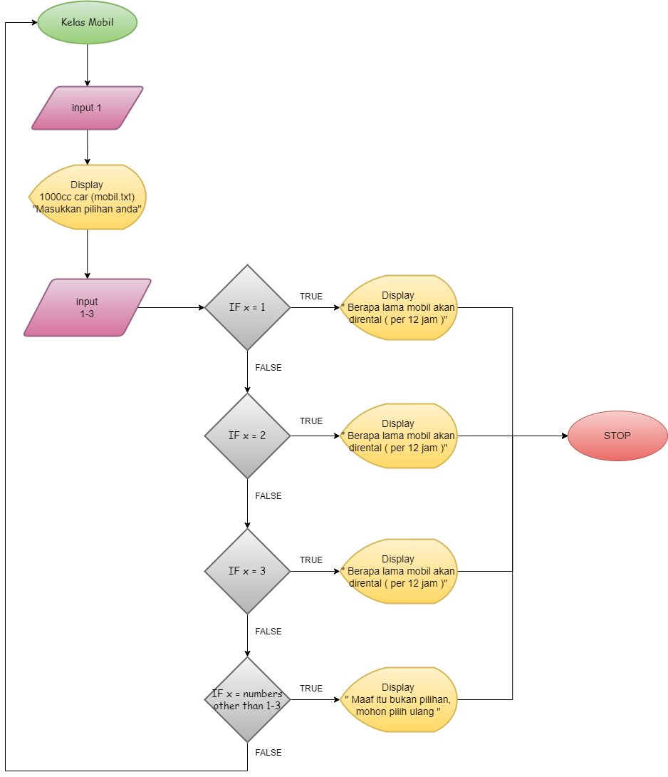
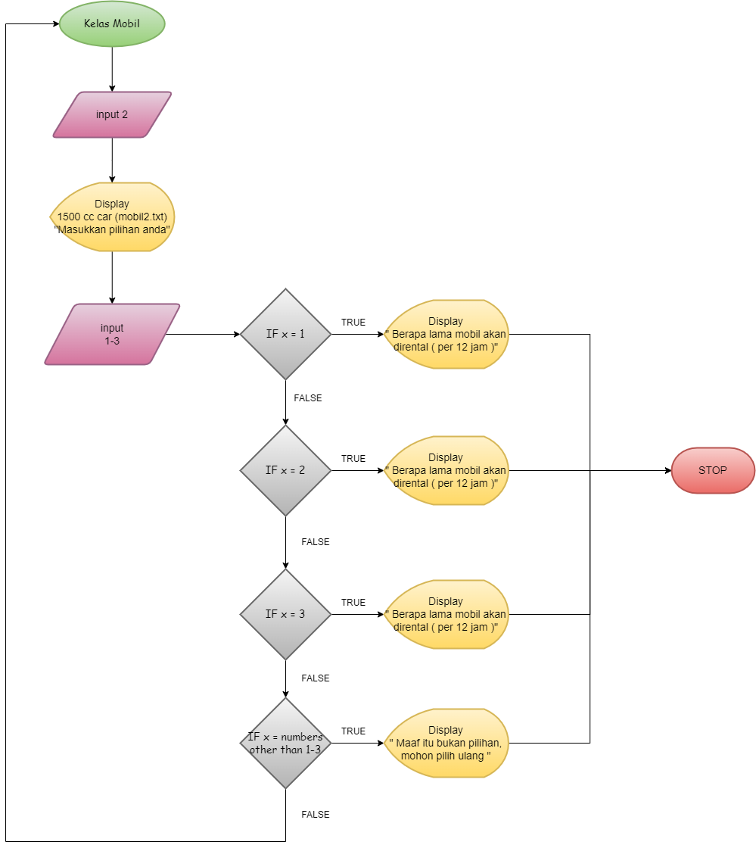
1000 CC RENT CAR
1500 CC RENT CAR

Slide 10
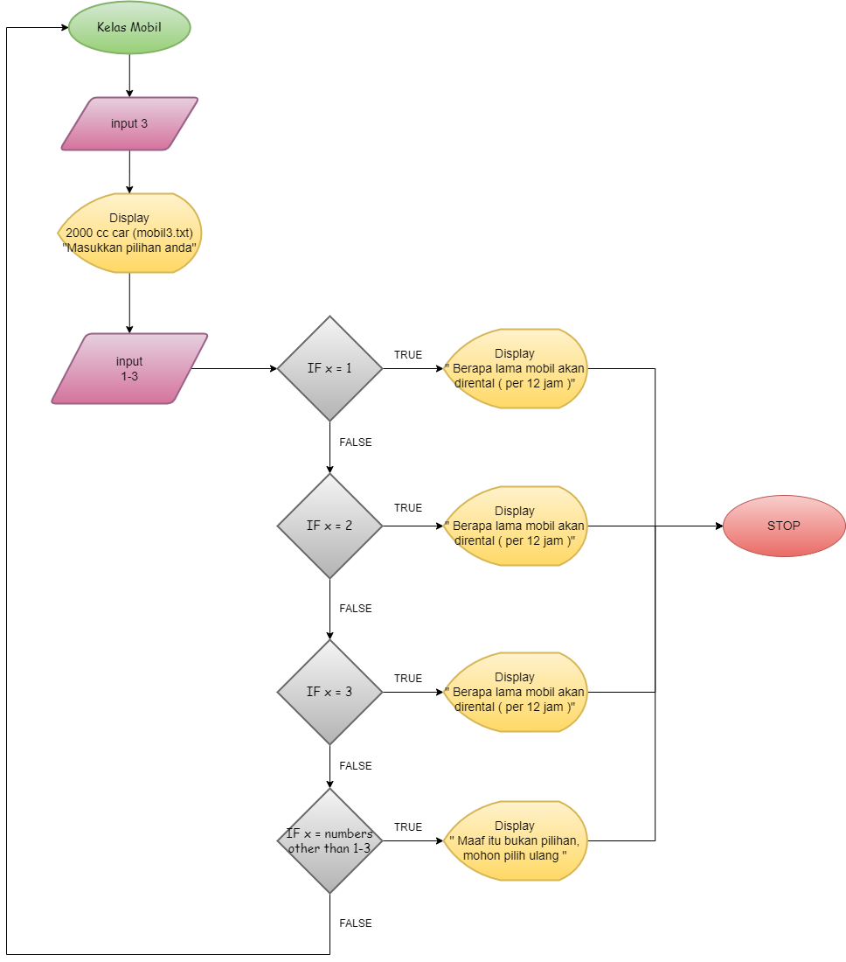
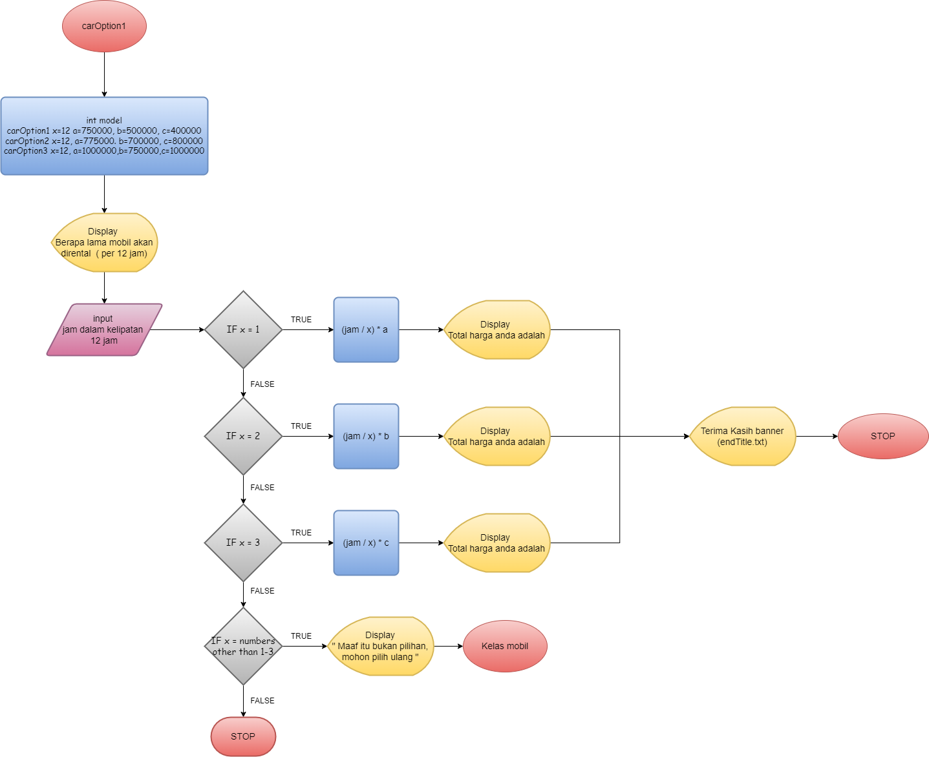
2000 CC RENT CAR
CAR INPUT TO FINAL PAYMENT

Slide 11
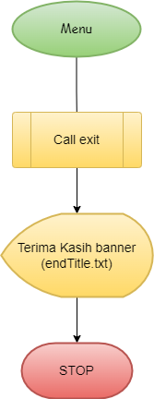
EXIT

Slide 12
03
OUTPUT PROGRAM

Slide 13
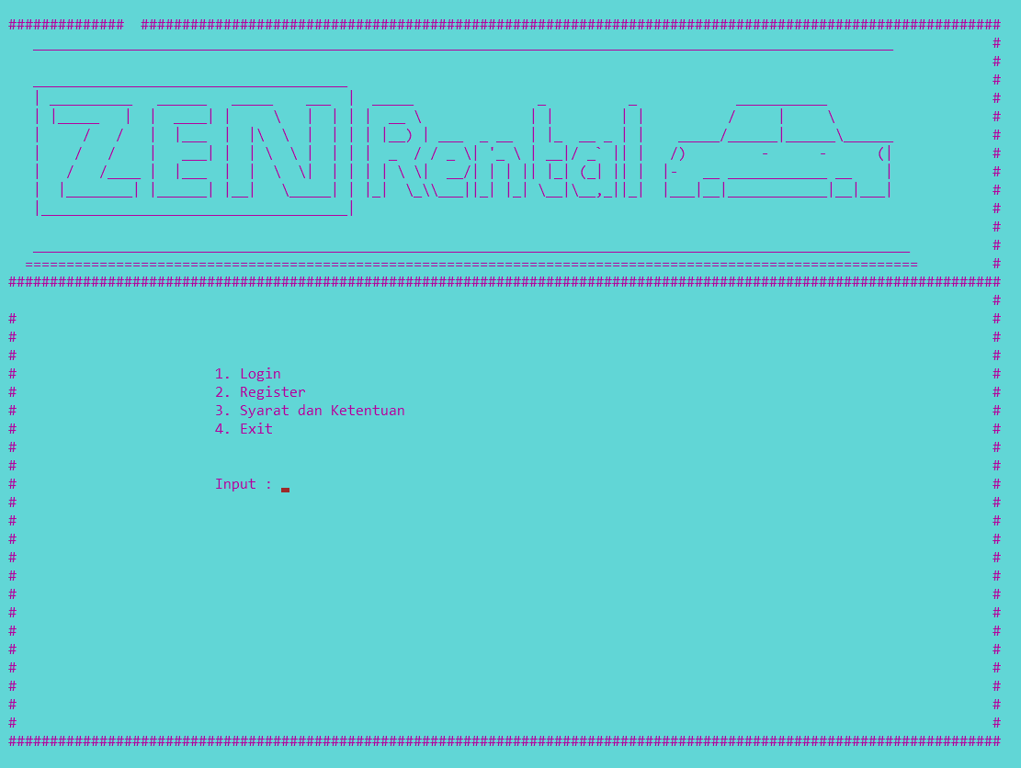
Main menu

Slide 14
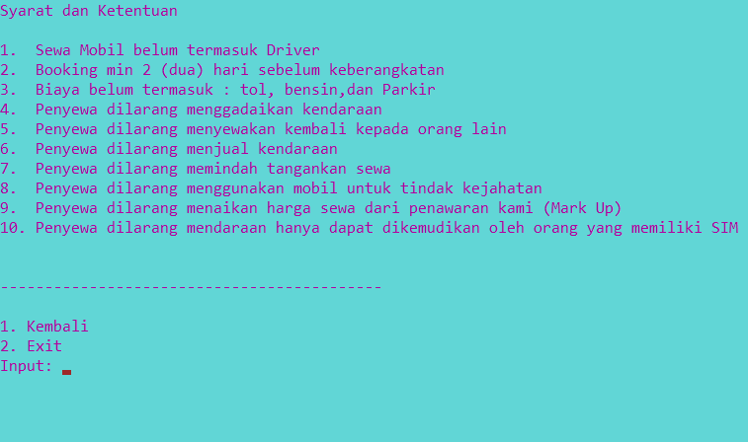
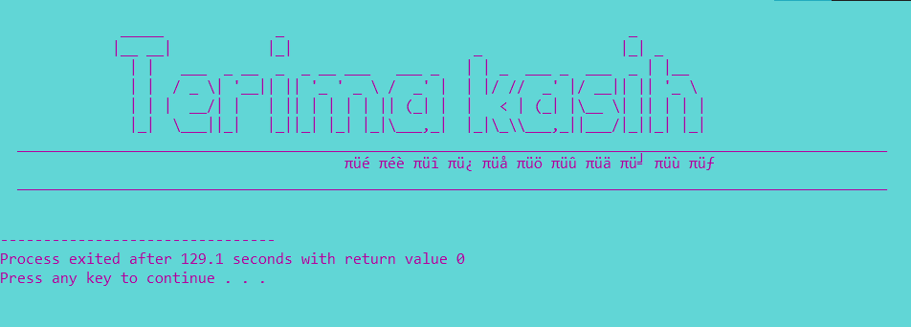
IF INPUT = 3
TERMS & CONDITION
IF INPUT = 4
DISPLAY “Terima kasih” banner (endtitle.txt)

Slide 15
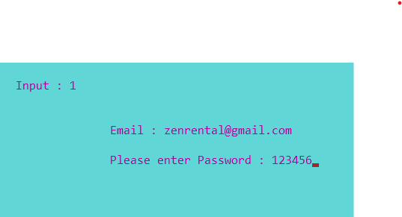
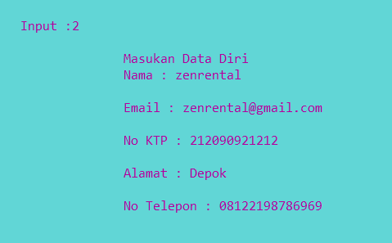
IF INPUT = 1
EXISTING ACCOUNT
IF INPUT = 2
NEW ACCOUNT

Slide 16
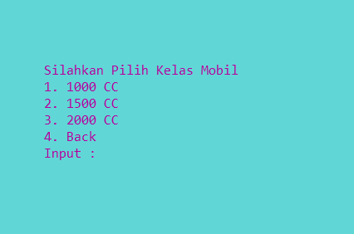
AFTER INPUT 1 OR 2
program ordered choose 1-4

Slide 17
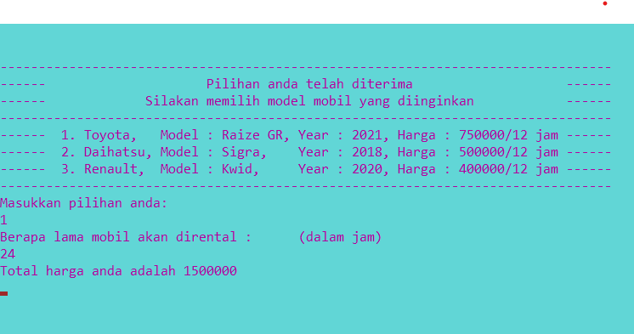
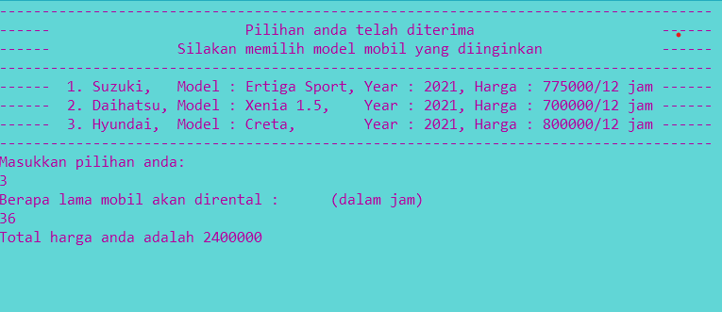
IF INPUT = 1
1000 cc car page [mobil.txt]
IF INPUT = 2
1500 cc car page [mobil2.txt]

Slide 18
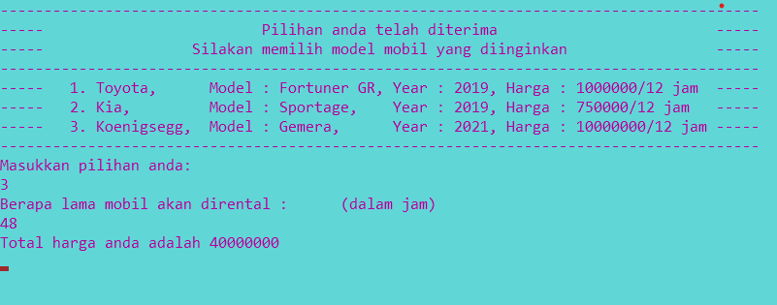
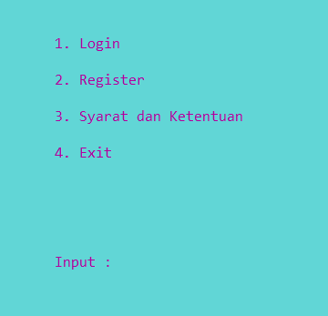
IF INPUT = 3
2000 cc car page [mobil3.txt]
IF INPUT = 4
Going back to main menu page

Slide 19
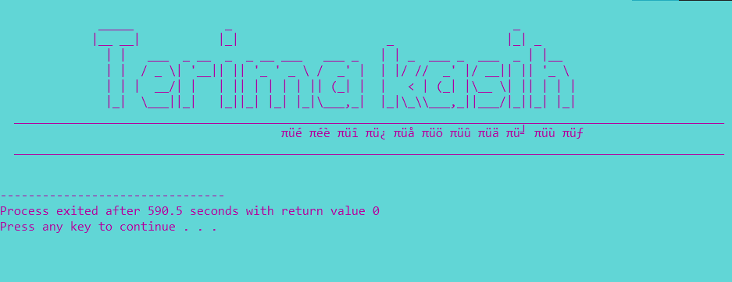
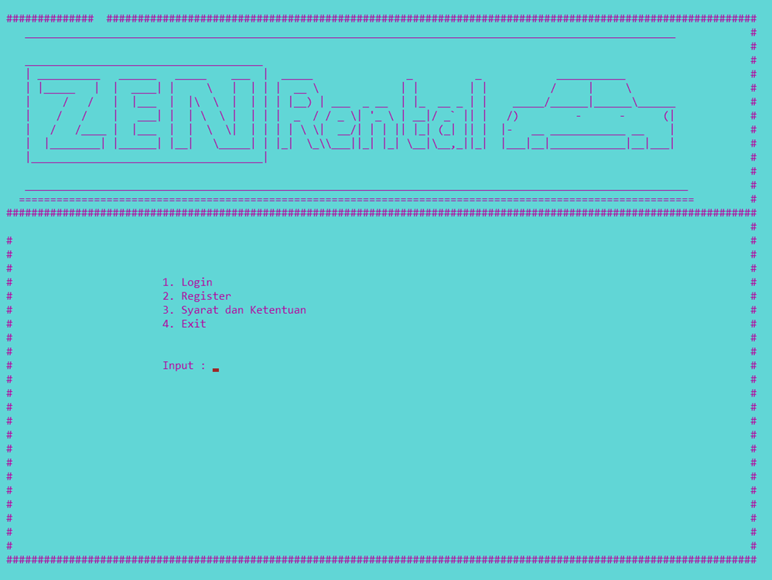

Last page after booking car [endtitle.txt]
after endtitle.txt Loop back to main menu

Slide 20
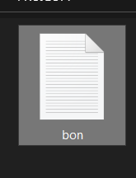
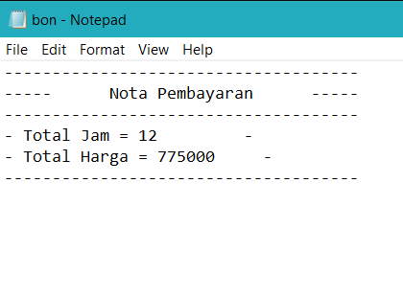
the final result of the rental will be made a receipt which will be input to the bon.txt

Slide 21
THANK YOU

